Slide 1

Apache Wicket
Dima Ionut Daniel

Slide 2
Contents
What is Apache Wicket?
History
Architecture
Features
Core
Validation
Advanced Features
Example
Bibliography

Slide 3

What is Apache Wicket?
Apache Wicket is a lightweight component-based web framework similar to JSF and Tapestry.
Wicket is component orientedd and relies on java servlet specification and runs in a Servlet container.

Slide 4
History
It was written by Jonathan Locke in April 2004.
Version 1.0 was released in June 2005.
It was added to Apache top-level project in June 2007.
Apache Wicket 1.5.0 was released in 09-07-2011 after many improvements.
Version 1.6.4 released in 2013, containing JQuery 1.8.3, bootstrap 2.2.2, JSR-303 BeanValidation support.

Slide 5
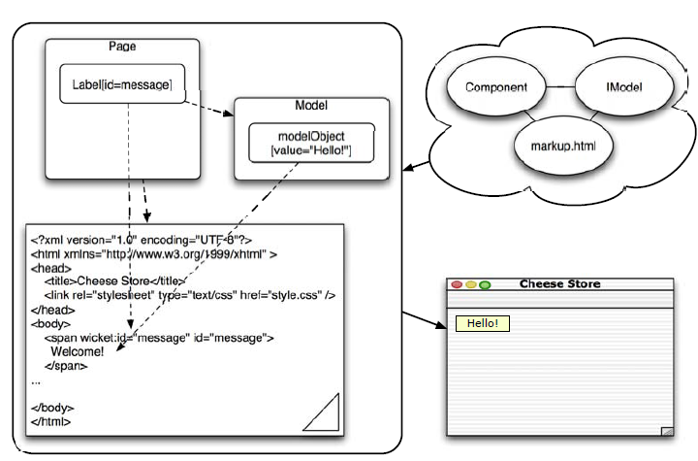
Architecture

Slide 6
Features
POJO Component Model
pages and components are Java objects that supports encapsulation, inheritance, events.
Separetion of Concerns
HTML and Java are connected using only Wicket ids, which are attributes in HTML and component properties in Java
Secure
Wicket is secure by default.
URLs do not expose sensitive information and all component paths are session-relative.
Reusable Components
We can create reusable components.
Localization
HTML pages and resource strings can be localized.
Attributes manipulation
Wicket components can change any HTML tag attribute.
Factory Customizable
Wicket is very extensible, through factories or factory methods.

Slide 7
Core
All Wicket pages extend the WebPage class.
There is a one-to-one correspondence between HTML widgets with a wicket:id attribute and the Page components.
Wicket components need to be supplied with an id parameter and an IModel implementation.
The model object acts as a source of data for the component.
The components's id value must match the wicket:id attribute of the template's corresponding HTML component.
When a page is requested, Wicket knows the HTML template it maps to by looking at the Page class with an .html extenstion from same class package.

Slide 8
Core (cont.)
During render phase Wicket it's:
1.Render page by calling Page.render() method.
2.Page locates markup template and begins iterating over HTML tags converting into Java representation.
3.If a tag without wicket:id is found, it's rendered as is.
4.If a tag with wicket:id is found, the component in the Page is located an rendering is delegated to the component.
5.Page instance is stored in an intrnal store called PageMap. Wicket has one PageMap per user session.

Slide 9
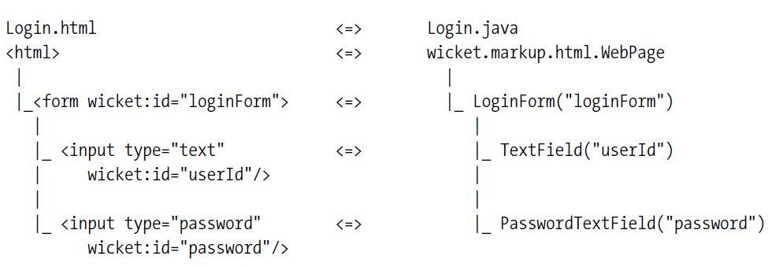
Core (cont.)
In Wicket the component hierarchy is specified in Java Code, which allows the modularization and reusability of the components.

Slide 10
Core (cont.)
WicketServlet expects to be supplied with an IWebApplicationFactory implementation in order to delegate the responsibility of creating the WebApplication class.
A factory implementation can be specified as a servlet initialization parameter in web.xml using the key applicationFactoryClassName.
If there is no such property WicketServlet will use ContextParamWebApplicationFactory by default.
The mandatory web.xml parameter is applicationClassName.

Slide 11
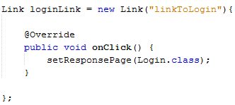
Core (cont.)
After the page is rendered it's put into a PageMap.
When a form is submitted, the page is taken from PageMap and the form handler is executed.
The PageMap uses a Least Recently Used(LRU) algorithm.
We can configure Wicket with own implementation(custom IPageMapEvictionStrategy) of the eviction strategy.
This can be done in WebApplication.init() by invoking getSessionSettings().setPageMapEvictionStrategy().
The Link element can be used to navigate through pages.

Slide 12
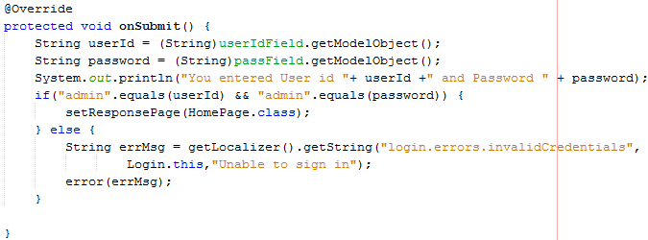
Validation
Wicket has FeedbackPanel component that can display all types of messages associate with components nested within a page. Messages are attached to a component.
If we are using internationalization we can use the Localizer class that will retrieve error locale-specific messages.

Slide 13
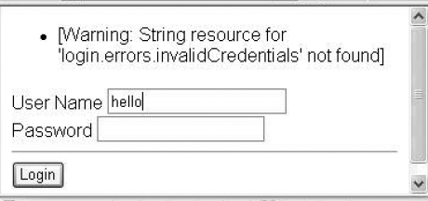
Validation (cont.)
We can use other Localizer method that will look for keys in the Login.properties file.
String errmsg = getLocalizer().getString("login.errors.invalidCredentials ", this);
In case the file is missing an exception will be thrown.
In order to suppress the exception the getExceptionSettings().setThrowExceptionOnMissingResource(false) in WebApplication can be used.

Slide 14
Validation (cont.)
The Form can validate all contained FormCoponents by calling the validator registered with each component.
It will traverse all components tree and will call validate() on each component.
Validation is specified through the IValidator interface.
We can use the setRequired(true) method to force certain components to be required.
Wicket uses default Application.properties key property file.
Bundle validators: RangeValidator, StringValidator, PatternValidator, CompoundValidator.

Slide 15
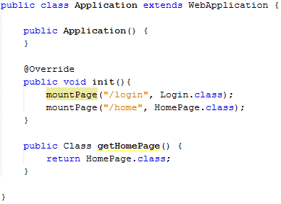
Advanced Features
When we start the application Wicket will create the following URL:
http://<host>:<port>/webapp_context/wicket_servlet_mapping?wicket:bookmarkablePage=fully_qualfied_name_of_the_page_class
We can change this in WebApplication by mapping Page classes to URLs.
We need to use the mountPage() method in the WebApplication.init() method.

Slide 16
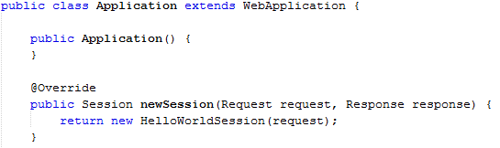
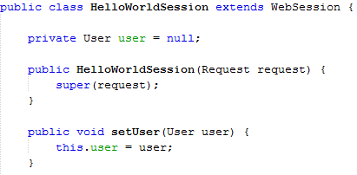
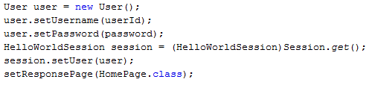
Advanced Features (cont.)
All Wicket components have access to the session using the Session.get() method.
The concrete implementation class is WebSession.
We can extend the WebSession and inject our session implementaiton in WebApplication.

Slide 17
Advanced Features (cont.)
Wicket can embed Velocity/FreeMarker template in Wicket pages.
Wicket can achieve localization unsing <wicket:message key="name"> tag.
The Locale can be set using getSession().setLocale(newLocale).
Wicket supports also the use of Ajax.

Slide 18
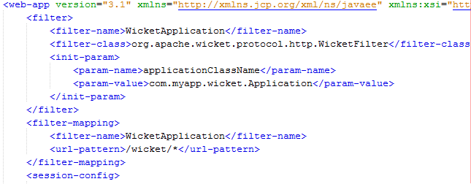
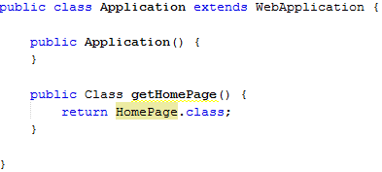
Example
In Web.xml we define the Wicket applicationClassName as attribute to WicketFilter.
Also we mapped the application under wicket subcontext.
The WebApplication class is the main entry.

Slide 19
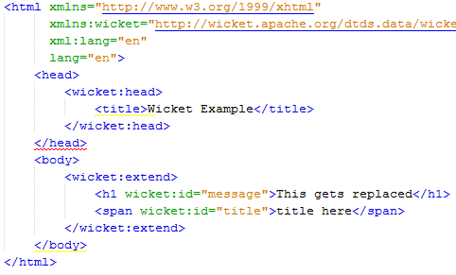
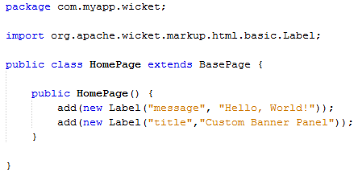
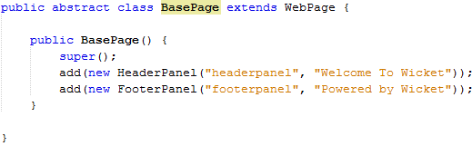
Example (cont.)

Slide 20
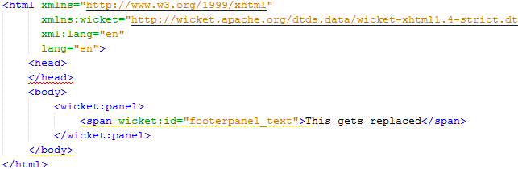
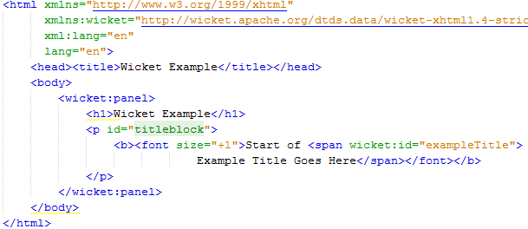
Example (cont.)

Slide 21

Bibliography
http://en.wikipedia.org/wiki/Apache_Wicket
Apress - Pro Wicket

